Slide 1
Lambda Architecture
Pravin Y Pawar

Slide 2
Lambda Architecture
Defined
Proposed by Nathan Marz based on his experience working on distributed data processing systems at Backtype and Twitter
A generic, scalable and fault-tolerant data processing architecture
Lambda Architecture
aims to satisfy the needs for a robust system that is fault-tolerant, both against hardware failures and human mistakes
being able to serve a wide range of workloads and use cases
in which low-latency reads and updates are required.
The resulting system should be linearly scalable, and it should scale out rather than up.

Slide 3
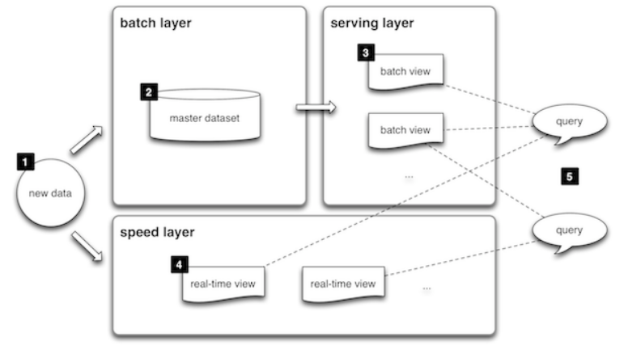
Lambda Architecture (2)
Block Diagram
Source : http://lambda-architecture.net/

Slide 4
Lambda Architecture (3)
Basic Flow of Events
All data entering the system is dispatched to both the batch layer and the speed layer for processing.
The batch layer has two functions:
managing the master dataset (an immutable, append-only set of raw data)
to pre-compute the batch views.
The serving layer indexes the batch views so that they can be queried in low-latency, ad-hoc way.
The speed layer compensates for the high latency of updates to the serving layer and deals with recent data only.
Any incoming query can be answered by merging results from batch views and real-time views.

Slide 5
Architectural Components (1)
Batch layer
New data comes continuously, as a feed to the data system.
It gets fed to the batch layer and the speed layer simultaneously.
It looks at all the data at once and eventually corrects the data in the stream layer.
Here we can find lots of ETL and a traditional data warehouse.
This layer is built using a predefined schedule, usually once or twice a day.
The batch layer has two very important functions:
To manage the master dataset
To pre-compute the batch views.
Source : https://databricks.com/glossary/lambda-architecture

Slide 6
Architectural Components (2)
Speed Layer (Stream Layer)
This layer handles the data that are not already delivered in the batch view due to the latency of the batch layer.
In addition, it only deals with recent data in order to provide a complete view of the data to the user by creating real-time views.
Speed layer provides the outputs on the basis enrichment process and supports the serving layer to reduce the latency in responding the queries.
As obvious from its name the speed layer has low latency because it deals with the real time data only and has less computational load.

Slide 7
Architectural Components (3)
Serving Layer
The outputs from batch layer in the form of batch views and from speed layer in the form of near-real time views are forwarded to the serving layer.
This layer indexes the batch views so that they can be queried in low-latency on an ad-hoc basis.

Slide 8
Applications of Lambda Architecture
User queries are required to be served on ad-hoc basis using the immutable data storage.
Quick responses are required and system should be capable of handling various updates in the form of new data streams.
None of the stored records shall be erased and it should allow addition of updates and new data to the database.

Slide 9
Pros and Cons of Lambda Architecture
Pros
Batch layer of Lambda architecture manages historical data with the fault tolerant distributed storage which ensures low possibility of errors even if the system crashes.
It is a good balance of speed and reliability.
Fault tolerant and scalable architecture for data processing.
Cons
It can result in coding overhead due to involvement of comprehensive processing.
Re-processes every batch cycle which is not beneficial in certain scenarios.
A data modelled with Lambda architecture is difficult to migrate or reorganize.
Source : https://towardsdatascience.com/a-brief-introduction-to-two-data-processing-architectures-lambda-and-kappa-for-big-data

Slide 10
Thank You!
In our next session: Kappa Architecture

